Slide 1
Stock Price Prediction based on
Machine Learning Technique
and Two Applications
Group 1
Junru Liu, Yachun Zhang, Biyao Wang, Yiduo Zhang, Chen Huang, Zelai Yu

Slide 2
Presentation Roadmap
Overview
Data Summary
Intro
1
2
Model
Model Fitting
Feature Selection
3
2
1
Apply
Model Selection
1
2
Q&A
Trading Strategy
Execution & Result

Slide 3

Aim to build a machine learning model to predict direction of price movement, and then use the results to construct trading strategy and improve execution of large trade order
Machine Learning
to develop a deeper understanding of
market microstructure

Slide 4
Data Summary
Training Set
Testing Set
October
November
December
W1
W2
W3
W4
W5
W6
W7
W8
W9
W10
W11-W12
Input (Minute Data):
Open High Low Close Volume
Output:
Trading Signal
Target: 10 US large-cap stocks (source: Minute data for S&P 500 composite stocks)
Selecting Criteria: High Volume, High Liquidity
Processing
Calculate the average of open, high, low and close prices
Using average price to determine price movement direction

Slide 5
Prediction Model

Slide 6
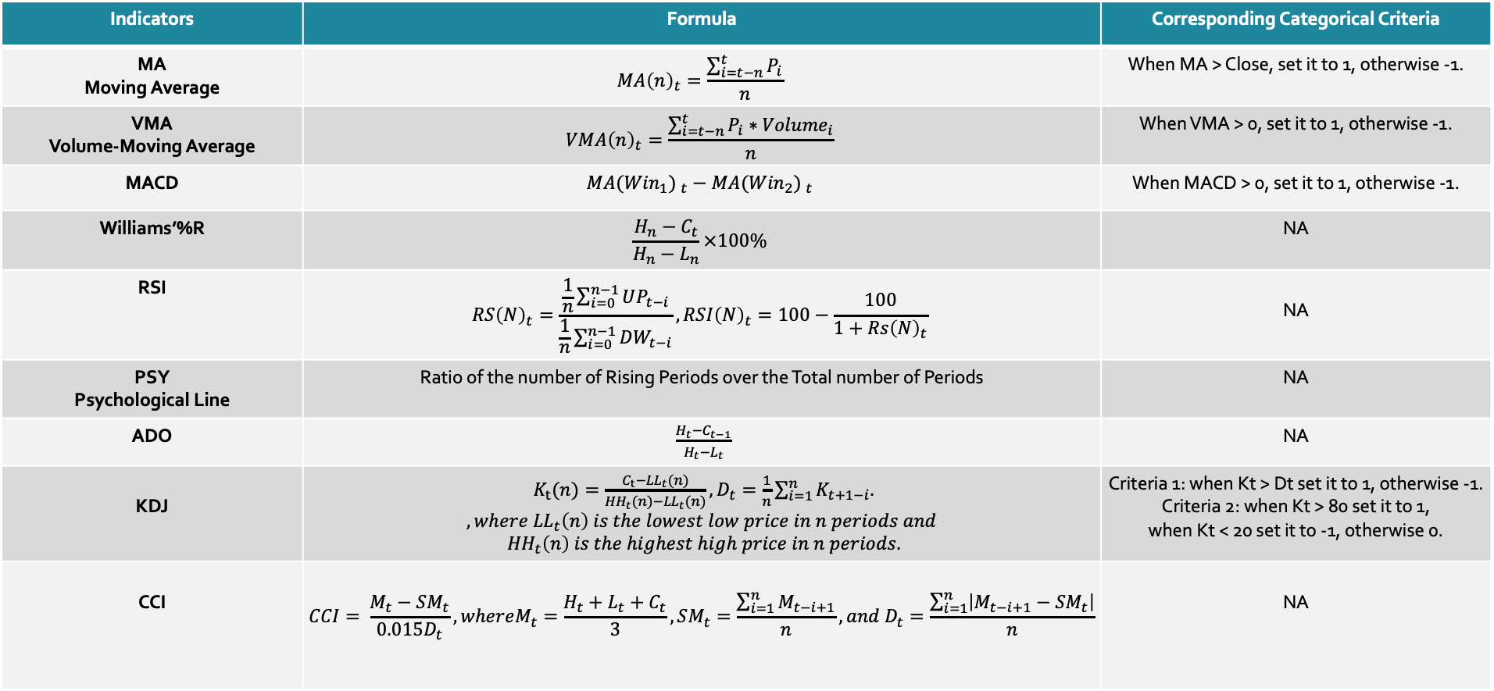
Technical Indicators
Indicators | Formula | Corresponding Categorical Criteria
MA Moving Average | $$MA{\left(n\right)}_{t}=\frac{\sum_{i=t−n}^{t}{P_{i}}}{n}$$ | When MA > Close, set it to 1, otherwise -1.
VMA Volume-Moving Average | $$VMA{\left(n\right)}_{t}=\frac{\sum_{i=t−n}^{t}{P_{i}∗{Volume}_{i}}}{n}$$ | When VMA > 0, set it to 1, otherwise -1.
MACD | $${MA({Win}_{1}) }_{t}−{MA({Win}_{2}) }_{t}$$ | When MACD > 0, set it to 1, otherwise -1.
Williams’%R | $$\frac{H_{n}−C_{t}}{H_{n}−L_{n}}×100\%$$ | NA
RSI | $$RS{\left(N\right)}_{t}=\frac{\frac{1}{n}\sum_{i=0}^{n−1}{UP_{t−i}}}{\frac{1}{n}\sum_{i=0}^{n−1}{DW_{t−i}}}, RSI{\left(N\right)}_{t}=100−\frac{100}{1+Rs{\left(N\right)}_{t}}$$ | NA
PSY Psychological Line | Ratio of the number of Rising Periods over the Total number of Periods | NA
ADO | $\frac{H_{t}−C_{t−1}}{H_{t}−L_{t}}$ | NA
KDJ | $K_{t}(n)=\frac{C_{t}−{LL}_{t}(n)}{{HH}_{t}(n)−{LL}_{t}(n)}, D_{t}=\frac{1}{n}\sum_{i=1}^{n}{K_{t+1−i}.}$ $$, where {LL}_{t}\left(n\right) is the lowest low price in n periods and$$ $${HH}_{t}\left(n\right) is the highest high price in n periods.$$ | Criteria 1: when Kt > Dt set it to 1, otherwise -1. Criteria 2: when Kt > 80 set it to 1, when Kt < 20 set it to -1, otherwise 0.
CCI | $$CCI= \frac{M_{t}−SM_{t}}{0.015D_{t}}, whereM_{t}=\frac{H_{t}+L_{t}+C_{t}}{3},SM_{t}=\frac{\sum_{i=1}^{n}{M_{t−i+1}}}{n}, and D_{t}=\frac{\sum_{i=1}^{n}{\left|M_{t−i+1}−{SM}_{t}\right|}}{n}$$ | NA

Slide 7
Parameters in Indicators
Indicator | Parameters | Parameters Used | Notation
MA | N | 3, 5, 10, 15, 20, 30 | MA_N, MA_CAT_N
VMA | N | 3, 5, 10, 15, 20, 30 | VMA_N, VMA_CAT_N
MACD | (N1, N2) | (3, 5), (5, 10), (5, 15), (5, 30), (10, 15), (10, 20), (10, 30), (15,30) | MACD_N1_N2, MACD_CAT_N1_N2
RSI | N | 10, 20, 30 | RSI_N
PSY | N | 10, 15, 30 | PSY_N
KDJ | (N, M) | (5, 3), (15, 3) | K_N, D_N_M, K_D_CAT_N_M, K_D_CAT_B_N_80_20
CCI | N | 5 | CCI_N

Slide 8
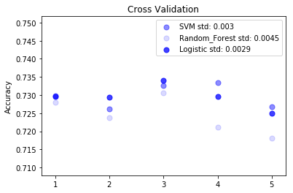
Cross Validation
5-Fold Cross Validation:
Applied to training set
Candidate Models:
SVM: linear model
Random Forest: 100 trees, depth limit 5
Logistic Regression

Slide 9
Model Selected: Logistic Regression
Consistency
Significance
Stepwise
Cost
Robust results from cross-validation, with higher and more consistent out-of-sample prediction accuracy
Generating probability prediction, which can be used as a proxy for signal significance
Stepwise process is applicable for feature selection
Lower computational costs

Slide 10
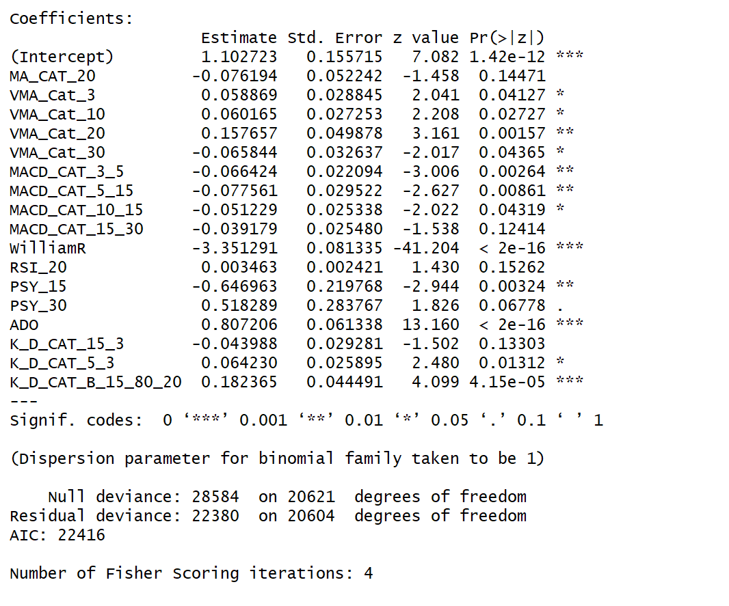
Feature Selection(1/3)
Example: AAPL
Full model:
Original Indicators for William%R, AD Oscillator, RSI, PSY and CCI, and
Categorical indicators for MA, VMA, MACD and KDJ, with selected parameters
Selection process:
Applying stepwise process with training set data, using AIC as selection criteria

Slide 11
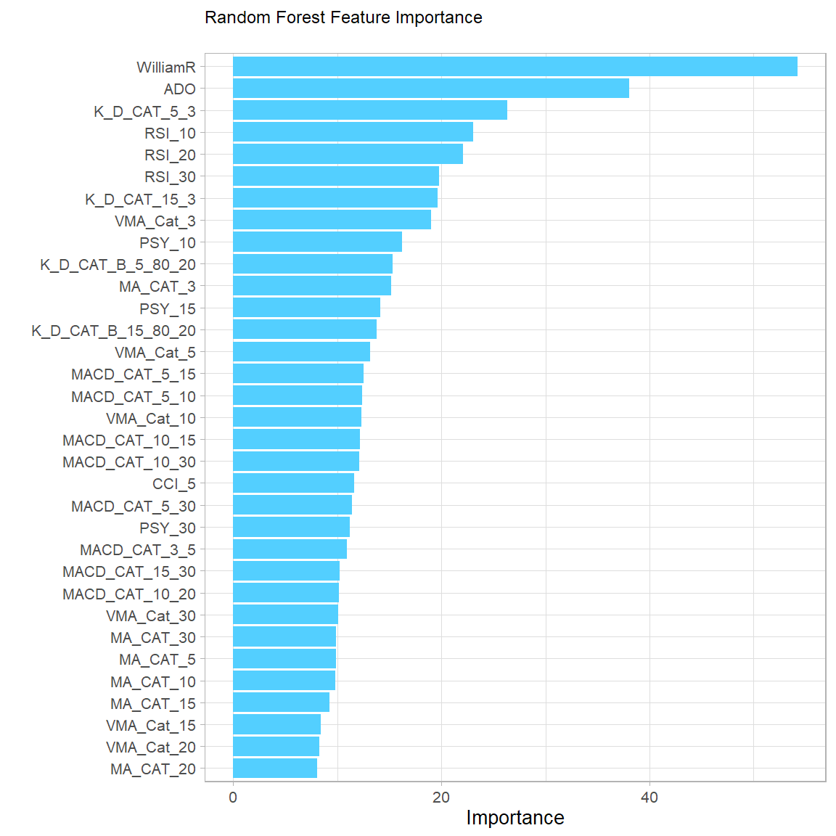
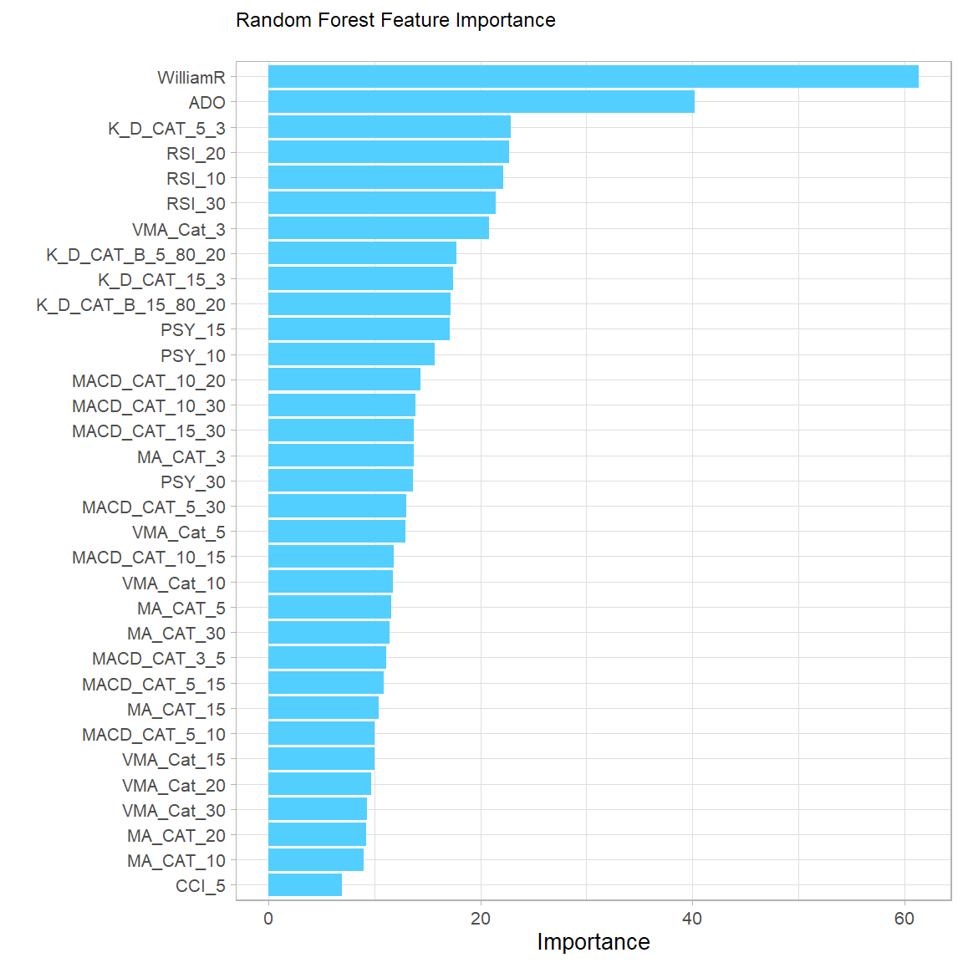
Feature Selection(2/3) - Feature Importance
Example: AMZN
Example: AAPL

Slide 12
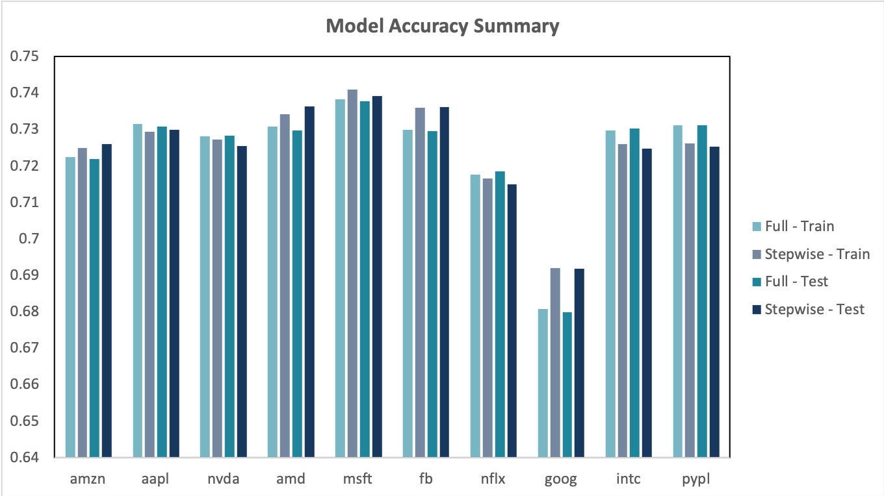
Feature Selection (3/3) - Result

Slide 13
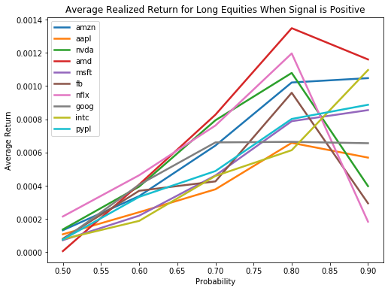
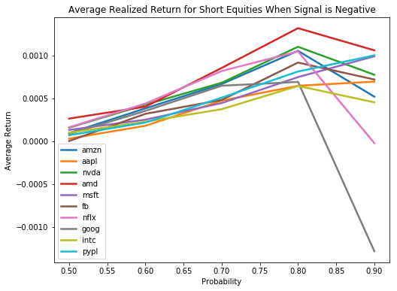
Probability Prediction from Logistic Regression

Slide 14
Trading Strategy

Slide 15
Rationale
Basic Rule:
Open a long position when predicted direction change is 1, open a short position when it is -1
Assumptions:
1. Invest all the capital when open a long position 2. 100% margin requirement for short position 3. Transaction cost is simplified as a percentage of nominal trading amount

Slide 16
Backtest Results (*Assuming 0.03% transaction cost)
Stocks | Return (10 days) | Sharpe Ratio | Drawdown | Drawdown Period | Calmar Ratio
AAPL | 64.07% | 7.56 | 7.63% | 155 min | 8.39
AMZN | 246.30% | 12.00 | 21.70% | 152 min | 11.35
NVDA | 338.51% | 14.27 | 18.55% | 113 min | 18.25
AMD | 636.44% | 15.81 | 17.70% | 117 min | 35.96
MSFT | 115.41% | 10.16 | 7.03% | 101 min | 16.42
FB | 165.18% | 11.70 | 9.97% | 119 min | 16.57
NFLX | 393.95% | 15.11 | 19.07% | 126 min | 20.65
GOOG | 70.40% | 6.66 | 5.84% | 329 min | 12.05
INTC | 46.30% | 6.48 | 4.65% | 269 min | 9.96
PYPL | 124.26% | 10.50 | 4.46% | 262 min | 27.88

Slide 17
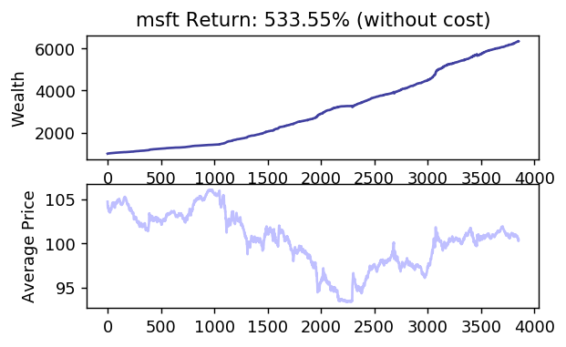
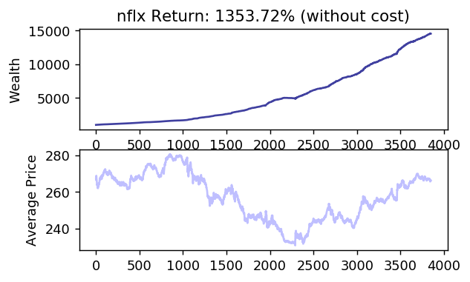
Example: No Transaction Cost

Slide 18
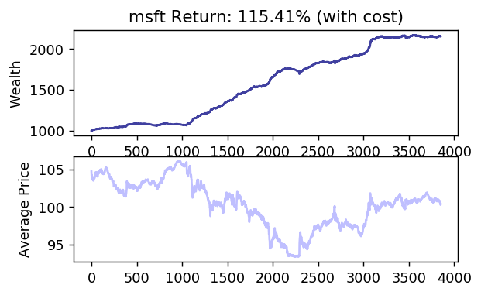
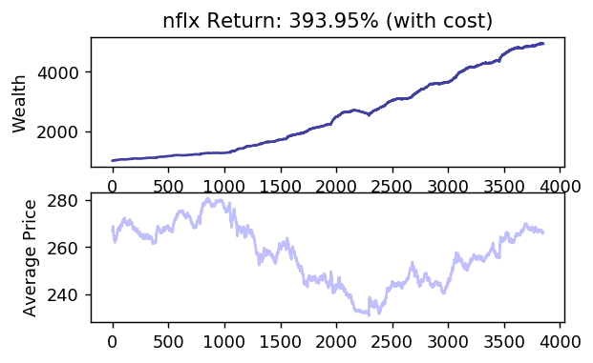
Example: 0.03% Transaction Cost

Slide 19
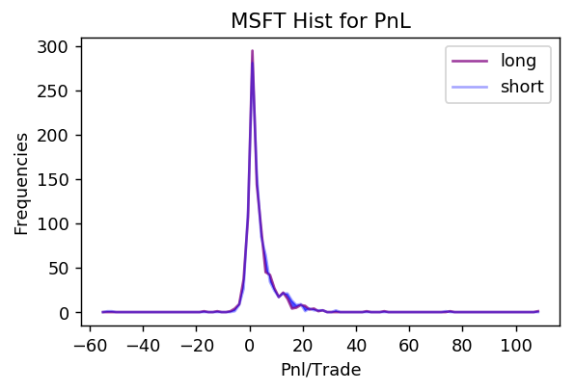
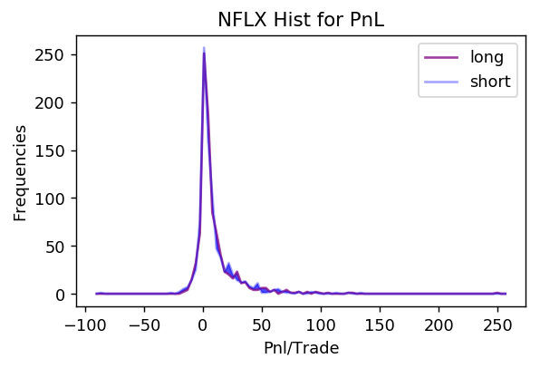
P&L per Trade

Slide 20
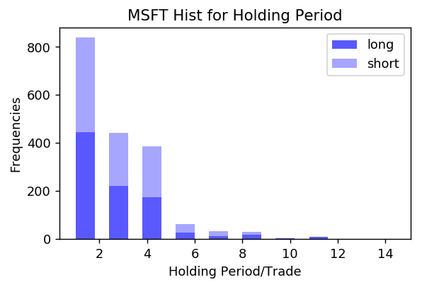
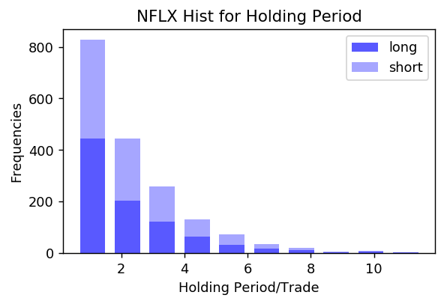
Holding Period

Slide 21
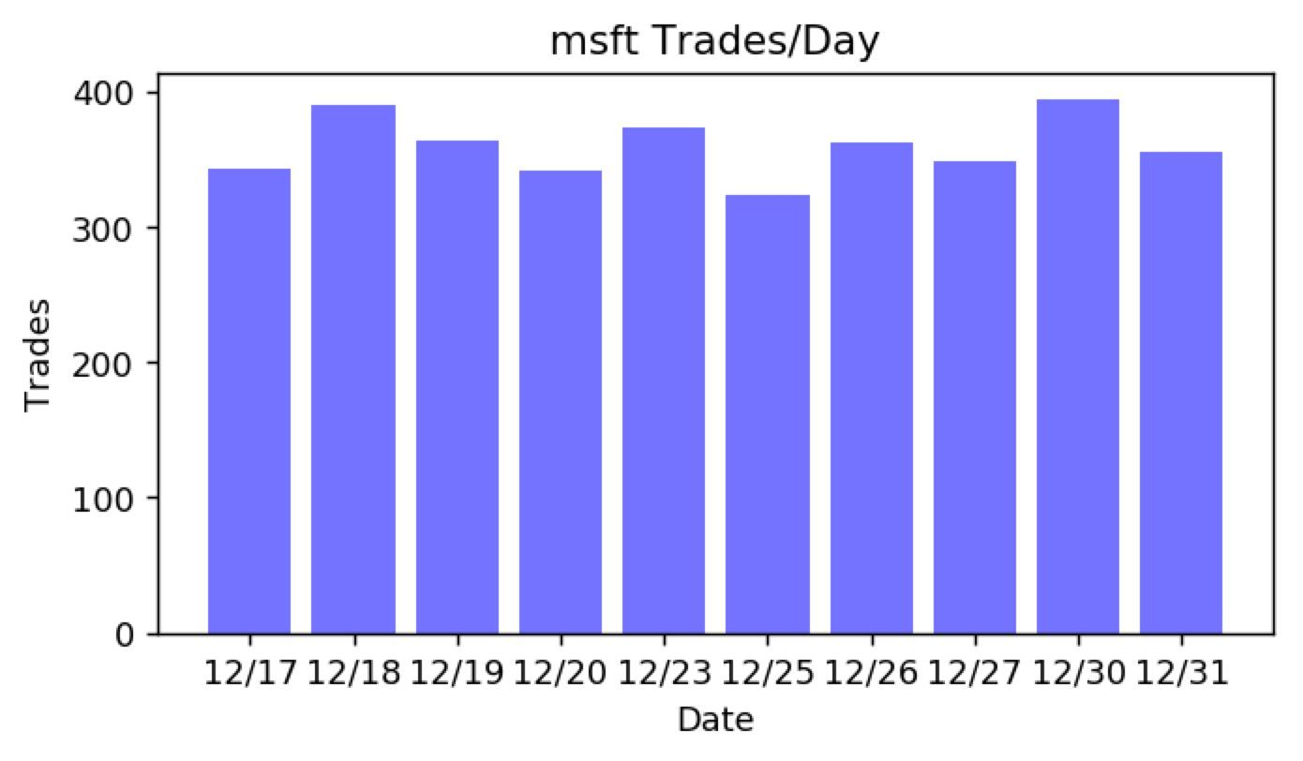
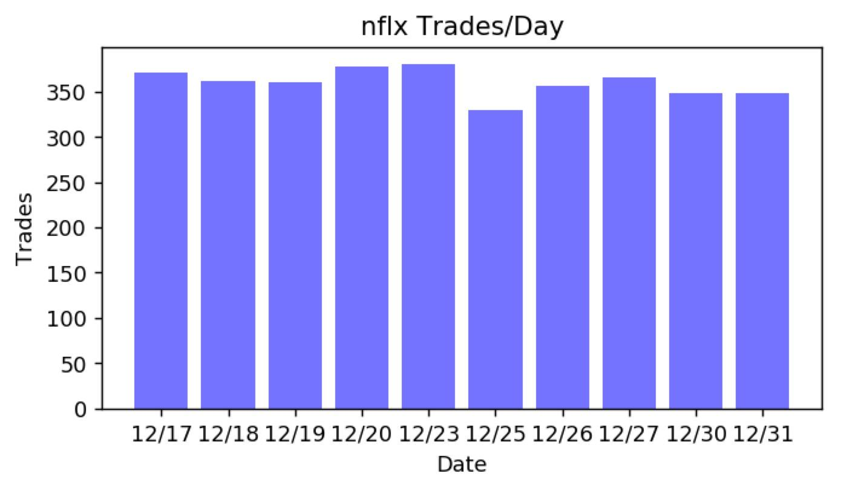
Number of Trades

Slide 22
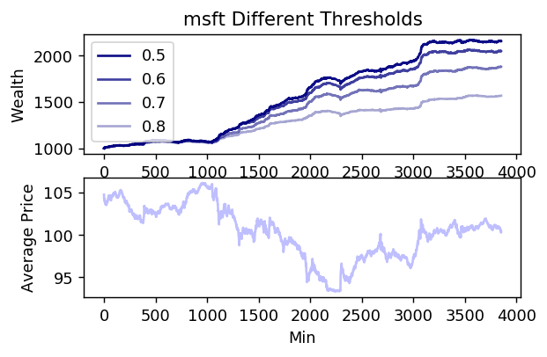
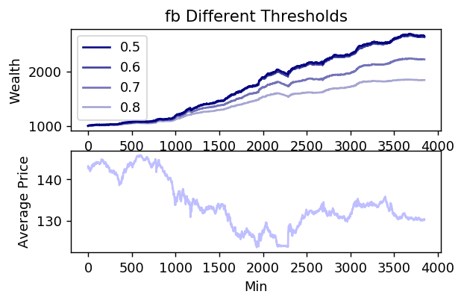
Probability Threshold(1/2)

Slide 23
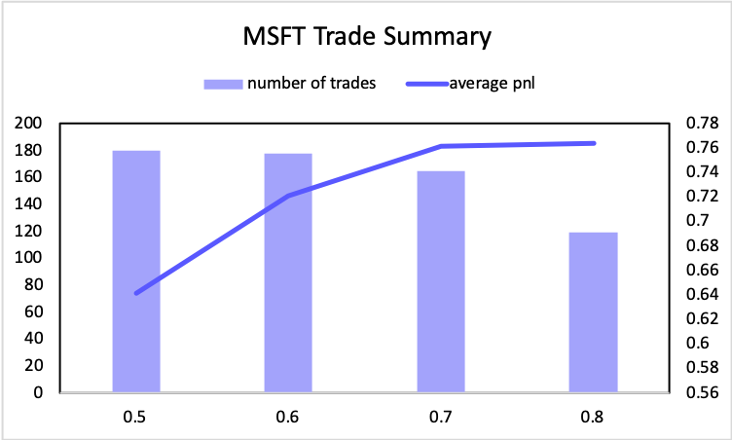
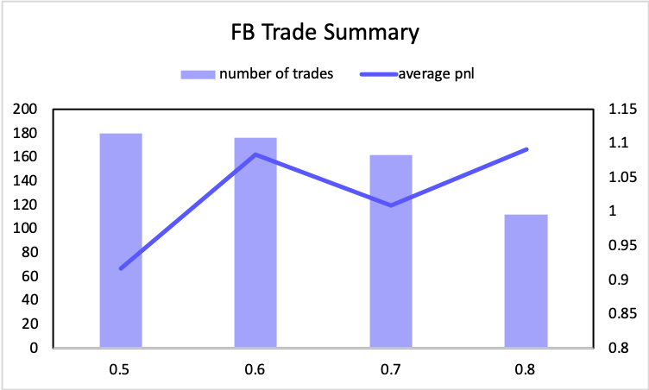
Probability Threshold(2/2)

Slide 24
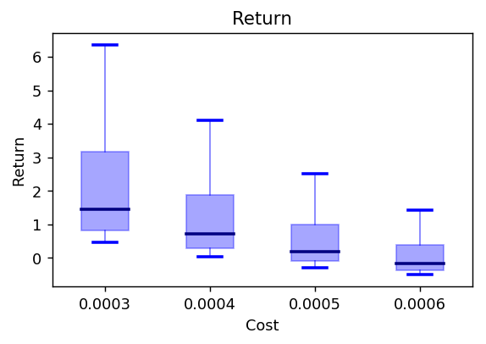
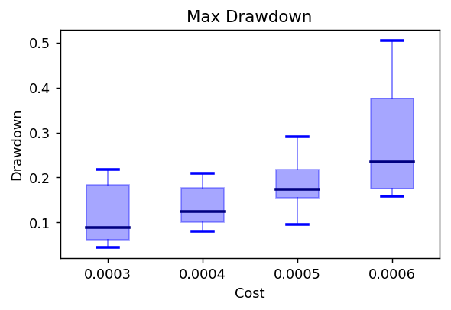
Transaction Costs

Slide 25
Summary
Before considering transaction, our strategy generates outstanding risk and return profile
Sensitive to transaction cost due to high trading frequency
Largest affordable cost is about 6 bp
Optimal choice for probability threshold is 0.5

Slide 26
Execution

Slide 27
ML-Enhanced VWAP Strategy
Idea
Considering we are executing the bid order.
If the market is expected to:
Main Goal
Utilizing short term price prediction to gain a better execution price.
Go up → Buy more now (Aggressive)
Go down → Buy less now (Passive)

Slide 28
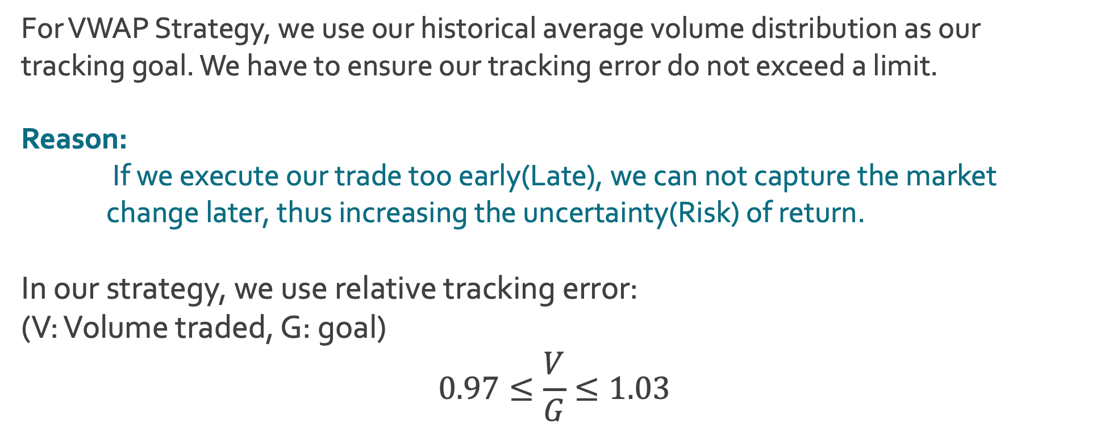
Tracking Error Limitation
For VWAP Strategy, we use our historical average volume distribution as our tracking goal. We have to ensure our tracking error do not exceed a limit. Reason:
If we execute our trade too early(Late), we can not capture the market change later, thus increasing the uncertainty(Risk) of return. In our strategy, we use relative tracking error: (V: Volume traded, G: goal) $$0.97≤\frac{V}{G}≤1.03$$

Slide 29
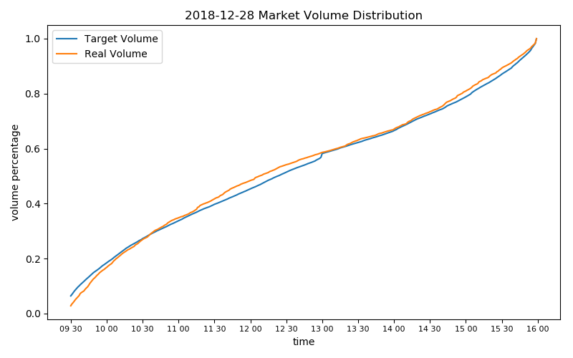
Historical Volume versus Realistic Volume

Slide 30
Our Model and Strategy
Slippage(Market Impact Model): Consider the more we trade, the more market impact we will have.

Slide 31
Market Impact Model(1/3)
Assume we can trade at mean( Open, Close, High, Low) if there is no market impact considered. Assume market impact is a linear function of volume: Slippage = F(volume)
For example , At time t, the market volumet is VOL and we trade 0.2*VOL at time t. The highest price we trade will be price+ 0.2*A*(High - price).
(A is sensitive constant.)

Slide 32
Market Impact Model(2/3)

Slide 33
Market Impact Model(3/3)
We optimize our trade volume at each minute by
MAX (Expected return)
S.T market impact_{t} ≤ Expected Profit_{t} highest trading price_{t} < Expected price_{t+1}

Slide 34
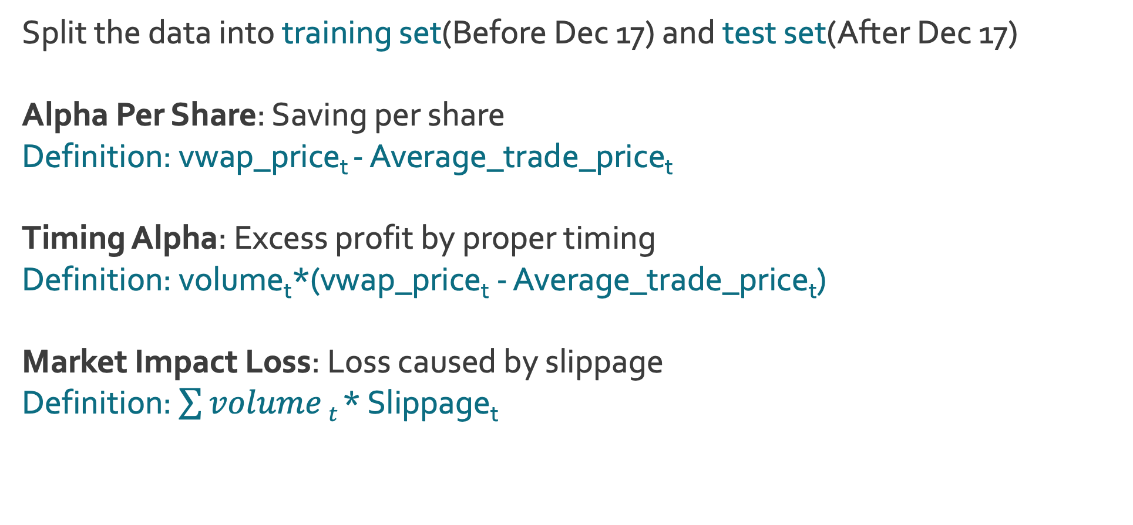
Strategy Performance
Split the data into training set(Before Dec 17) and test set(After Dec 17) Alpha Per Share: Saving per share Definition: vwap_price_{t} - Average_trade_price_{t}
Timing Alpha: Excess profit by proper timing Definition: volume_{t}*(vwap_price_{t} - Average_trade_price_{t}) Market Impact Loss: Loss caused by slippage Definition: $\sum{volume}t$ * Slippage_{t}

Slide 35
Strategy
Assume we want to buy 200,000 shares of AAPL in a certain day.
Result: We can buy at 0.11(7 bps) lower price per share compared with traditional VWAP strategy.

Slide 36
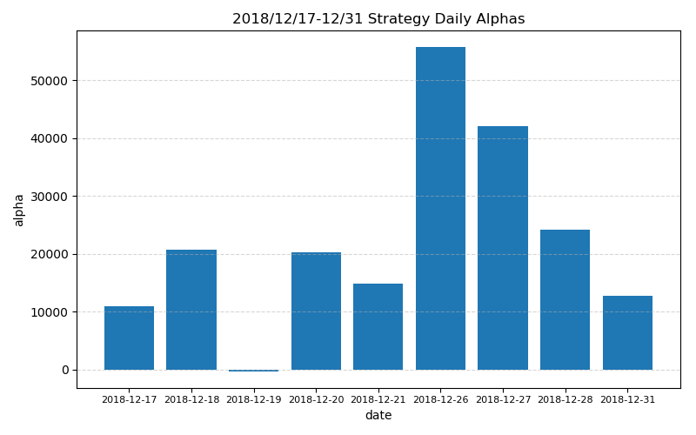
Strategy Performance in Testing Set

Slide 37
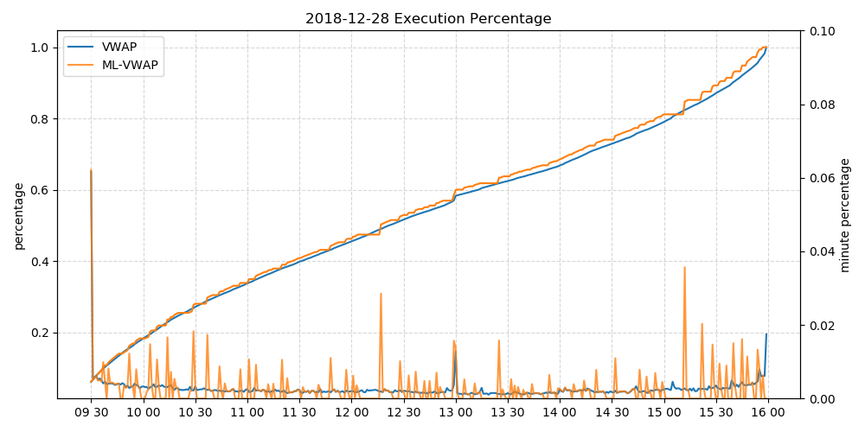
Strategy Comparation

Slide 38
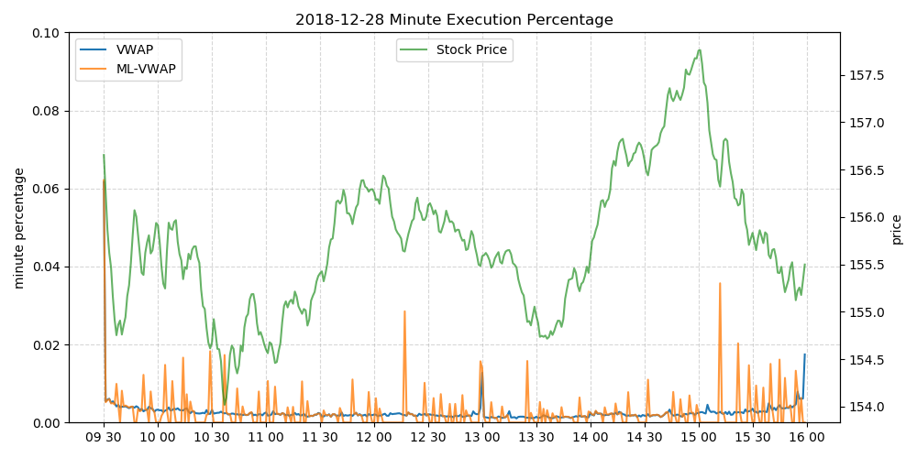
Price Change vs Optimal Execution

Slide 39
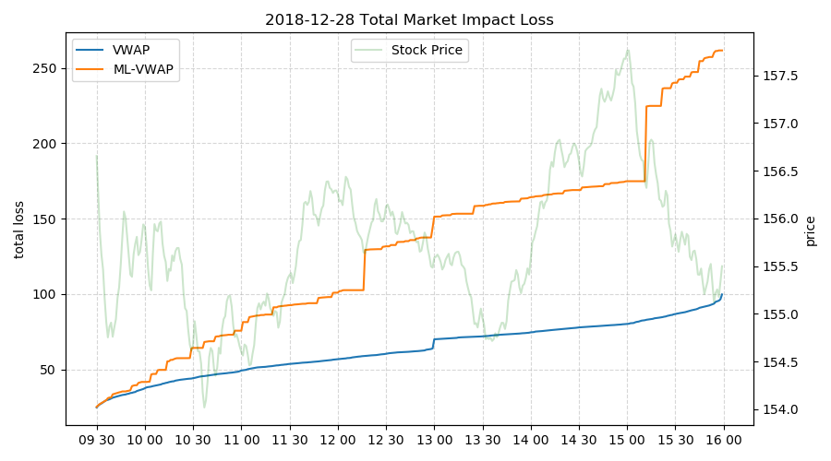
Aggressive Strategy Increases Market Impact

Slide 40
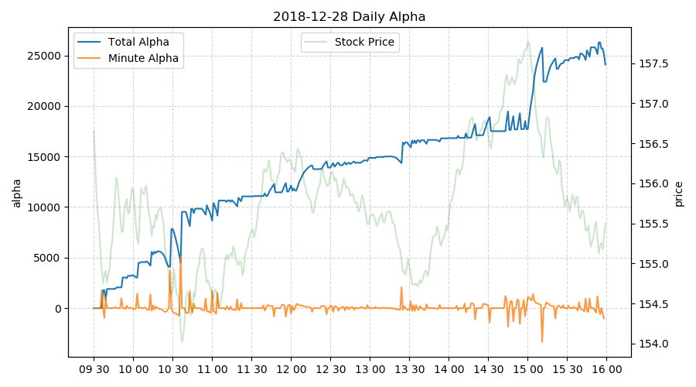
Cumulative Timing Alpha

Slide 41
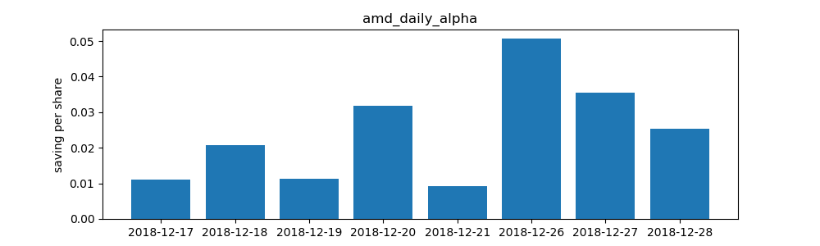
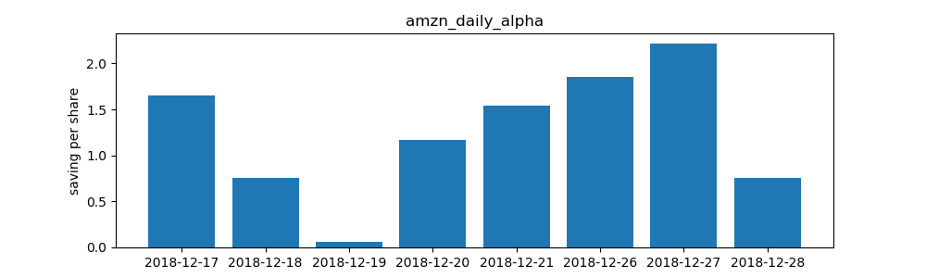
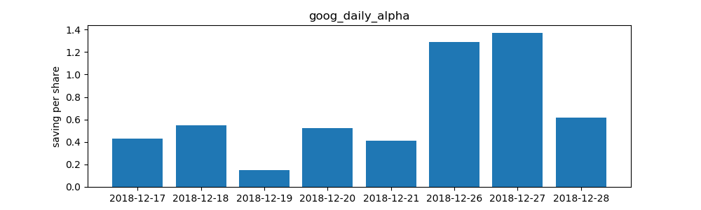
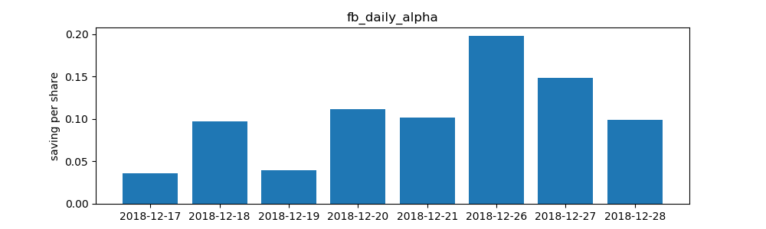
Results in Other Stocks

Slide 42
Where the Timing Alpha Comes from?
We find the alpha per share is proportional to the volatility of stock price. Compare our excess return with average price change per minute:
 | AAPL | AMZN | AMD | FB | GOOG
Average Saving Per Share | 0.11 | 1.25 | 0.024 | 0.104 | 0.67
Average Price Change | 0.096 | 1.57 | 0.022 | 0.114 | 0.761
Savings | 7bps | 9bps | 12bps | 7bps | 7bps

Slide 43
Conclusion
The prediction accuracy of the machine learning models is satisfactory (around 70%)
Trading strategy based on the results has robust performance but sensitive to transaction cost
Potential improvement ①: Increase volume prediction accuracy by using dynamic model
Potential improvement ②: Utilizing order book data to optimize slippage model

Slide 44
References
Ballings, M., Van den Poel, D., Hespeels, N., & Gryp, R. (2015). Evaluating multiple classifiers for stock price direction prediction. Expert Systems with Applications, 42(20), 7046-7056.
Chang, P. C., Fan, C. Y., & Lin, J. L. (2011). Trend discovery in financial time series data using a case based fuzzy decision tree. Expert Systems with Applications, 38(5), 6070-6080.
Chiu, D. Y., & Chen, P. J. (2009). Dynamically exploring internal mechanism of stock market by fuzzy-based support vector machines with high dimension input space and genetic algorithm. Expert Systems with Applications, 36(2), 1240-1248.
Choudhry, R., & Garg, K. (2008). A hybrid machine learning system for stock market forecasting. World Academy of Science, Engineering and Technology, 39(3), 315-318.
Hu, Y., Feng, B., Zhang, X., Ngai, E. W. T., & Liu, M. (2015). Stock trading rule discovery with an evolutionary trend following model. Expert Systems with Applications, 42(1), 212-222.
Kearns, M., & Nevmyvaka, Y. (2013). Machine learning for market microstructure and high frequency trading. High Frequency Trading: New Realities for Traders, Markets, and Regulators.
Patel, J., Shah, S., Thakkar, P., & Kotecha, K. (2015). Predicting stock and stock price index movement using trend deterministic data preparation and machine learning techniques. Expert Systems with Applications, 42(1), 259-268.
Patel, J., Shah, S., Thakkar, P., & Kotecha, K. (2015). Predicting stock market index using fusion of machine learning techniques. Expert Systems with Applications, 42(4), 2162-2172.
Tsai, C. F., Lin, Y. C., Yen, D. C., & Chen, Y. M. (2011). Predicting stock returns by classifier ensembles. Applied Soft Computing, 11(2), 2452- 2459.

Slide 45
Q & A

Slide 46
THANK YOU!

